Slide 1
Keywords Constants(integer, real, character, string) Literals Variables

Slide 2
Keywords
These are some reserved words in C which have predefined meaning to compiler called keywords.
Keywords are not to be used as variable and constant names.
All keywords have fixed meanings and these meanings cannot be changed.

Slide 3
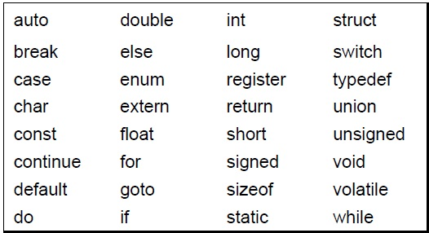
Compiler specific keywords (32)
Some commonly used keywords are given below:

Slide 4
Constants
Constants are data values that cannot be changed during the execution of a program. Like variables, constants have a type. In this section, we discuss Boolean, character, integer, real, complex, and string constants.
Topics discussed in this section:
Constant Representation
Coding Constants

Slide 5
Note
A character constant is enclosed in single quotes.
Use single quotes for character constants. Use double quotes for string constants.

Slide 6
Examples of Constant
Constant | Example
Decimal Constant | 10, 20, 450 etc.
Real or Floating-point Constant | 10.3, 20.2, 450.6 etc.
Octal Constant | 021, 033, 046 etc.
Hexadecimal Constant | 0x2a, 0x7b, 0xaa etc.
Character Constant | 'a', 'b', 'x' etc.
String Constant | "c", "c program", "c in javatpoint" etc.

Slide 7
Examples of Integer Constants

Slide 8
Examples of Real Constants

Slide 9
Examples of String Constants

Slide 10
Null Characters and Null Strings?
Characters and Strings its definitions are defined, but \0 is an explicit
representation where as in “” is an implicit representation?

Slide 11
Symbolic Names for Control Characters

Slide 12
Two ways to define constant
const keyword
#define preprocessor

Slide 13
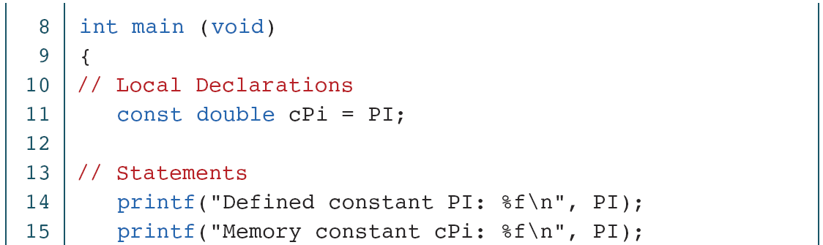
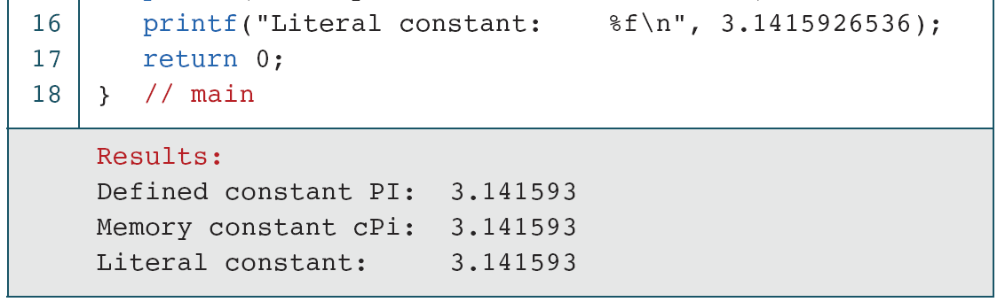
EXAMPLE PROGRAM

Slide 14
Literals
Literals are the constant values assigned to the constant variables. We can say that the literals represent the fixed values that cannot be modified.
For example, const int =10; is a constant integer expression in which 10 is an integer literal.
There are four types of literals that exist in C programming:
Integer literal
Float literal
Character literal
String literal

Slide 15
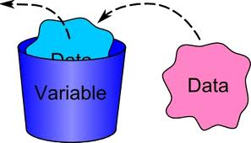
Variables
A variable is a container (storage area) to hold data
Variables are data storage locations in the computer’s memory.
To indicate the storage area, each variable should be given a unique name (identifier).
Example: float f=20.8; Here, f is variable

Slide 16
Variables
Variables are the symbolic names for storing computational data.
Variable: a symbolic name for a memory location
In C variables have to be declared before they are used Ex: int x;
A variable may take different values at different times during execution.
Declarations reserve storage for the variable.
Value is assigned to the variable by initialization or assignment

Slide 17
Variable declarations
Data type Variable name;
Which data types
are possible in C ?
Which variable names
are allowed in C ?

Slide 18
Variable Names- Identifiers
Symbolic names can be used in C for various data items used by a programmer.
A symbolic name is generally known as an identifier. An identifier is a name for a variable, constant, function, etc.
The identifier is a sequence of characters taken from C character set.

Slide 19
Variable names
Rules for valid variable names (identifiers) :
Name must begin with a letter or underscore ( _ ) and can be followed by any combination of letters, underscores, or digits.
Key words cannot be used as a variable name.
C is case-sensitive: sum, Sum, and SUM each refer to a different variable.
Variable names can be as long as you want, although only the first 63 (or 31) characters might be significant.
Choice of meaningful variable names can increase the readability of a program
Examples:
Sum
_difference
a
J5x7
Number_of_moves
3val
int

Slide 20
Declaring variables
C imposes to declare variables before their usage.
Advantages of variable declarations:
Putting all the variables in one place makes it easier for a reader to understand the program.
Thinking about which variables to declare encourages the programmer to do some planning before writing a program.
The obligation to declare all variables helps prevent bugs of misspelled variable names.
Compiler knows the amount of memory needed for storing the variable.
Compiler can verify that operations done on a variable are allowed by its type.

Slide 21
Using and Displaying Variables
#include <stdio.h>
int main ()
{
int sum;
sum = 50 + 25;
printf("The sum of 50 and 25 is%d”,sum);
return 0;
}
Variable sum declared of type int
Variable sum assigned expression 50+25
Value of variable sum is printed

Slide 22
Variables - Examples
int a; // declaring a variable of type int
int sum, a1, a2; // declaring 3 variables
int x = 7; // declaring and initializing a variable
a = 5; // assigning to variable a the value 5
a1 = a; // assigning to variable a1 the value of a
L-value
R-value
a1=a1+1; // assigning to variable a1 the value of a1+1
// (increasing value of a1 with 1)

Slide 23
Data types

Slide 24
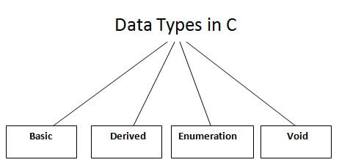
Comes under the category

Slide 25
Primary (built-in or Basic)Data types
INTEGER
CHARACTER
SIGNED TYPE UNSIGNED TYPE
INT UNSIGNED INT
SHORT INT UNSIGNED SHORT INT
LONG INT UNSIGNED LONG INT
SIGNED CHARACTER
UNSIGNED CHARACTER
FLOATING POINT TYPE
VOID
FLOATING POINT TYPE
FLOAT
DOUBLE
LONG DOUBLE
VOID

Slide 26
Data types
Basic data types: int, float, double, char, and void.
int: can be used to store integer numbers (values with no decimal places).
float: can be used for storing floating-point numbers (values containing decimal places).
double: the same as type float, and roughly twice the size of float.
char: can be used to store a single character, such as the letter a, the digit character 6, or a semicolon.
void: is used to denote nothing or empty.

Slide 27
Integer Types
The basic integer type is int
The size of an int depends on the machine and on PCs it is normally 16 or 32 or 64 bits.
modifiers (type specifiers)
short: typically uses less bits
long: typically uses more bits
Signed: both negative and positive numbers
Unsigned: only positive numbers

Slide 28
Size and Range of values for a 16-bit Machine (Integer type)
 | Type | Size (bits) | Range
short | short int or signed short int | 8 | -128 to 127
 | unsigned int | 8 | 0 to 255
Integer | int or signed int | 16 | -32,768 to 32,767
 | unsigned int | 16 | 0 to 65,535
Long | long int or signed long int | 32 | -2,147,483,648 to 2,147,483,647
 | unsigned long int | 32 | 0 to 4,294,967,295

Slide 29
The character type char
A char variable can be used to store a single character.
A character constant is formed by enclosing the character within a pair of single quotation marks. Valid examples: 'a’ .
Character zero ( ‘0’ ) is not the same as the number (integer constant) 0.
The character constant ‘\n’—the newline character—is a valid character constant. It is called as an escape character.
There are other escape sequences like, \t for tab, \v for vertical tab, \n for new line etc.

Slide 30
Character Types
Character type char is related to the integer type.
Modifiers(type specifiers) unsigned and signed can be used
char →1 byte (-128 to 127)
signed char →1 byte (-128 to 127)
unsigned char →1 byte (0 to 255)
ASCII (American Standard Code for Information Interchange ) is the dominant encoding scheme for characters.
Examples
' ' encoded as 32 '+' encoded as 43
'A' encoded as 65 …………………….'Z' encoded as 90
'a' encoded as 97 ……………………. 'z' encoded as 122
‘0’ encoded as 48 ……………………..’9’ encoded as 57

Slide 31
Assigning values to char
char letter; /* declare variable letter of type char */
letter = ‘A'; /* OK */
letter = A; /* NO! Compiler thinks A is a variable */
letter = “A"; /* NO! Compiler thinks “A" is a string */
letter = 65; /* ok because characters are internally stored as numeric values (ASCII code) */

Slide 32
Floating-Point Types
Floating-point types represent real numbers
Integer part
Fractional part
The number 108.1517 breaks down into the following parts
108 - integer part
1517 - fractional part
Floating-point constants can also be expressed in scientific notation. The value 1.7e4 represents the value 1.7 × 10⁴.
The value before the letter e is known as the mantissa, whereas the value that follows e is called the exponent.
There are three floating-point type specifiers
float
double
long double

Slide 33
SIZE AND RANGE OF VALUES FOR 16-BIT MACHINE (FLOATING POINT TYPE)
 | Type | Size
Single Precision | Float | 32 bits 4 bytes
Double Precision | double | 64 bits 8 bytes
Long Double Precision | long double | 80 bits 10 bytes

Slide 34
void
2 uses of void are
To specify the return type of a function when it is not returning any value.
To indicate an empty argument list to a function.

Slide 35
Summary of Memory Used
Data Types | Memory Size | Range
char | 1 byte | −128 to 127
signed char | 1 byte | −128 to 127
unsigned char | 1 byte | 0 to 255
short | 2 byte | −32,768 to 32,767
signed short | 2 byte | −32,768 to 32,767
unsigned short | 2 byte | 0 to 65,535
int | 2 byte | −32,768 to 32,767
signed int | 2 byte | −32,768 to 32,767
unsigned int | 2 byte | 0 to 65,535

Slide 36
Summary of Memory Used
Data Types | Memory Size | Range
short int | 2 byte | −32,768 to 32,767
signed short int | 2 byte | −32,768 to 32,767
unsigned short int | 2 byte | 0 to 65,535
long int | 4 byte | -2,147,483,648 to 2,147,483,647
signed long int | 4 byte | -2,147,483,648 to 2,147,483,647
unsigned long int | 4 byte | 0 to 4,294,967,295
float | 4 byte
double | 8 byte
long double | 10 byte

Slide 37
Important
You can always check the size of a variable using the sizeof() operator.
#include <stdio.h>
int main() {
short a;
long b;
long long c;
long double d;
printf("size of short = %d bytes\n", sizeof(a));
printf("size of long = %d bytes\n", sizeof(b));
printf("size of long long = %d bytes\n", sizeof(c));
printf("size of long double= %d bytes\n", sizeof(d));
return 0;
}

Slide 38
Best Practices for Programming
Naming Variables According to Standards
Prefix Data Type Example
i int and unsigned int iTotalMarks
f float fAverageMarks
d double dSalary
l long and unsigned long lFactorial
c signed char and unsigned char cChoice
ai Array of integers aiStudentId
af Array of float afQuantity
ad Array of double adAmount
al Array of long integers alSample
ac Array of characters acEmpName

Slide 39
Example: Using data types
#include <stdio.h>
int main ()
{
int integerVar = 100;
float floatingVar = 331.79;
double doubleVar = 144368.4411;
char charVar = 'W';
printf(“%d\n”, integerVar);
printf(“%f\n”,floatingVar);
printf(“%lf\n”,doubleVar);
printf(“%c\n”,charVar);
return 0;
}

